Slide 1
Personal Medical Cost Predication & Exploration Capstone 1 – Slide Deck Presentation
Jasim Rasheed

Slide 2
The strongest variable is Smoke that has strong correlation with charges
Correlation Chart
 | region | sex | children | bmi | smoker | age | charges
region | 1
sex | -0.00459 | 1
children | -0.01657 | 0.017163 | 1
bmi | -0.15757 | 0.046371 | 0.012759 | 1
smoker | 0.002181 | 0.076185 | 0.007673 | 0.00375 | 1
age | -0.00213 | -0.02086 | 0.042469 | 0.109272 | -0.02502 | 1
charges | 0.006208 | 0.057292 | 0.067998 | 0.198341 | 0.787251 | 0.299008 | 1

Slide 3
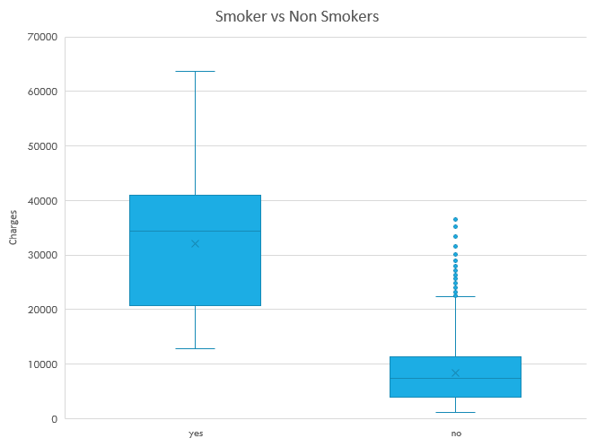
Smoking has a strong correlation with the charges . The box plot shows that smokers have more charges as compare to non-smokers

Slide 4
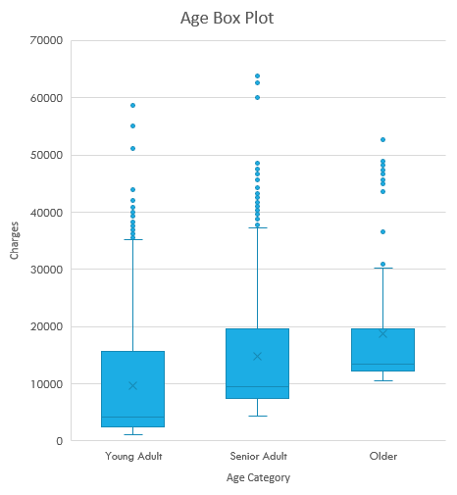
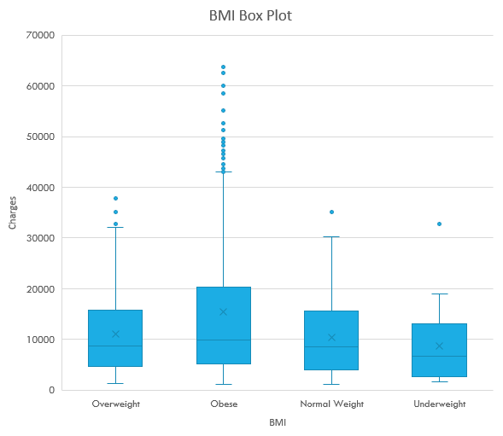
Smoking has a strong correlation with the charges . The box plot shows that smokers have more charges as compare to non-smokers

Slide 5

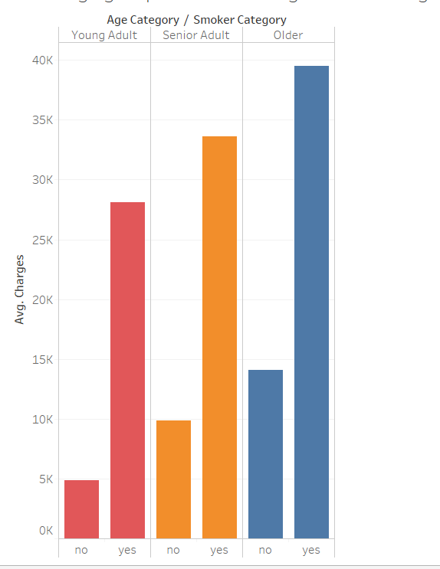
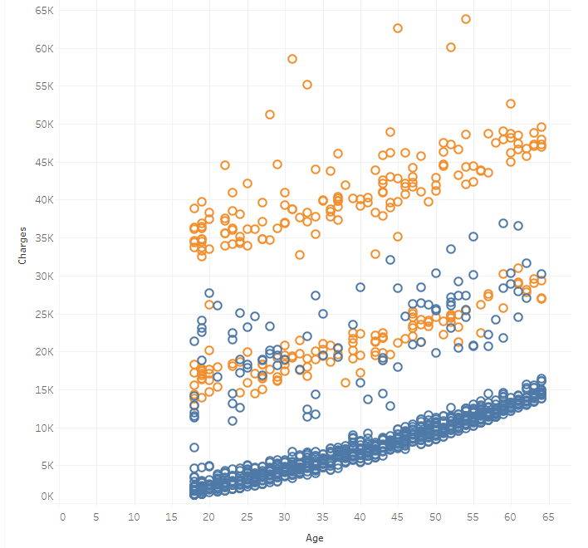
Charges and age have positive relation. Even non-smoker patients charges increases with the increasing age but smoker patients charges increases more as compare to non-smokers

Slide 6
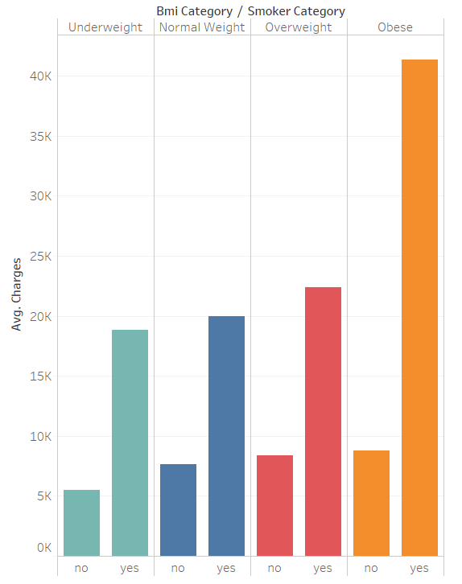
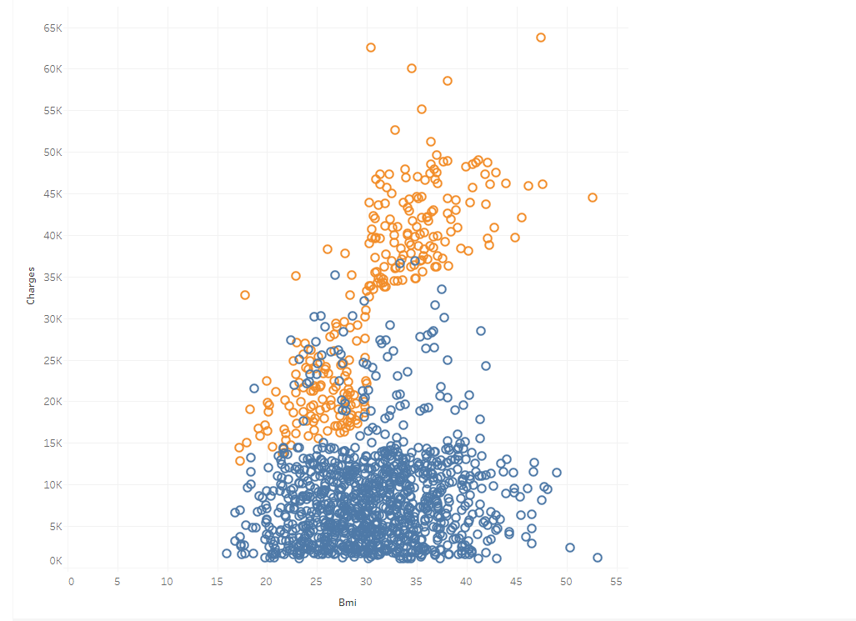
Charges and Bmi have a positive relationship. Smoking and increasing weight together increases the medical charges.

Slide 7
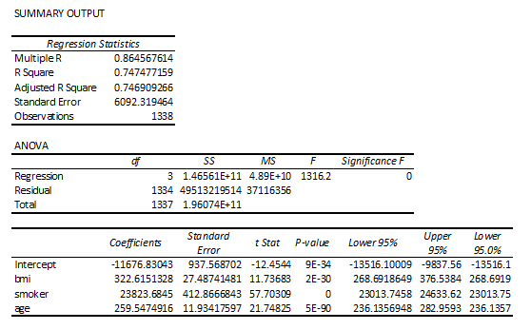
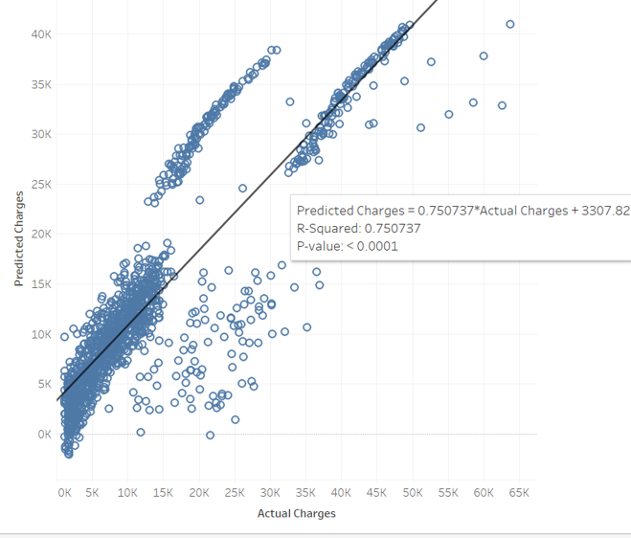
Regression Analysis
The model shows 74.8% of dependent variables are explained by independent variables
Multiple R is 0.86 that means correlation between the independent variables and dependent variable is 86.6%
The result of Adjusted R-square shows that 74.8% of dependent variables are explained by independent variables

Slide 8
Summary
This dataset is medical bills of patients
I used it to analyze which variables has bigger effects on medical bills
The result shows smoking has a strong correlation with charges
Other notable variables are Age and BMI.
Employers can use this finding to do something to stop their employees from smoking because employers pay higher premium for their smoker employees as compare to non-smokers

